Slide 1
Ofsted rating per school in the West Midlands
Project 3 – Group 2: Ryan Barker, SUWAIBA IDRIS, ARFAN HASSAN, ESALA KALUPERUMA, Farheen Oomatia

Slide 2
Table of content
Introduction
Data cleaning
SQLite Database
Flask app
Dashboard
Results & Conclusion

Slide 3
Introduction and Data Cleaning
Reduced columns to what was strictly needed in the analysis due to size of dataset
Changed numeric rating to string for better comprehension (dashboard)
Removed spaces, extra character (?) and added _ to column names
Changed data types for some of the columns (URN, pupil count & dates)
Added latitude and longitude per postcode

Slide 4
Creation of SQLITE database
Import dependencies, Python SQL toolkit and ORM
Loaded the cleaned CSV
Establishing a connection to SQLite database using the Python SQLite module

Slide 5
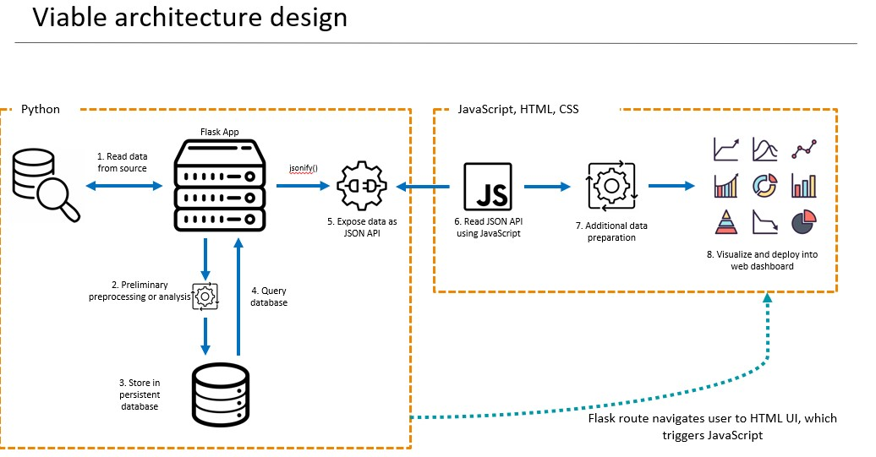
Flask app

Slide 6
FLASK APP
we created an SQLAlchemy engine for seamless connection to the SQLite database, "ofsted_results.sqlite."
In Flask setup, we crafted a robust web app with two key routes: the root ("/") for displaying routes and "/dashboard" to render a specific template.
The "/dashboard" route is pivotal, initiating a session, executing a SQL query to extract comprehensive data from "ofsted_data," transforming it into a pandas DataFrame, and gracefully concluding the session.
Data transformation results in JSON file creation, preserving processed information. We render the "index.html" template to present data in a structured, visually appealing manner.
Running the Flask app provides users with a dynamic dashboard

Slide 7
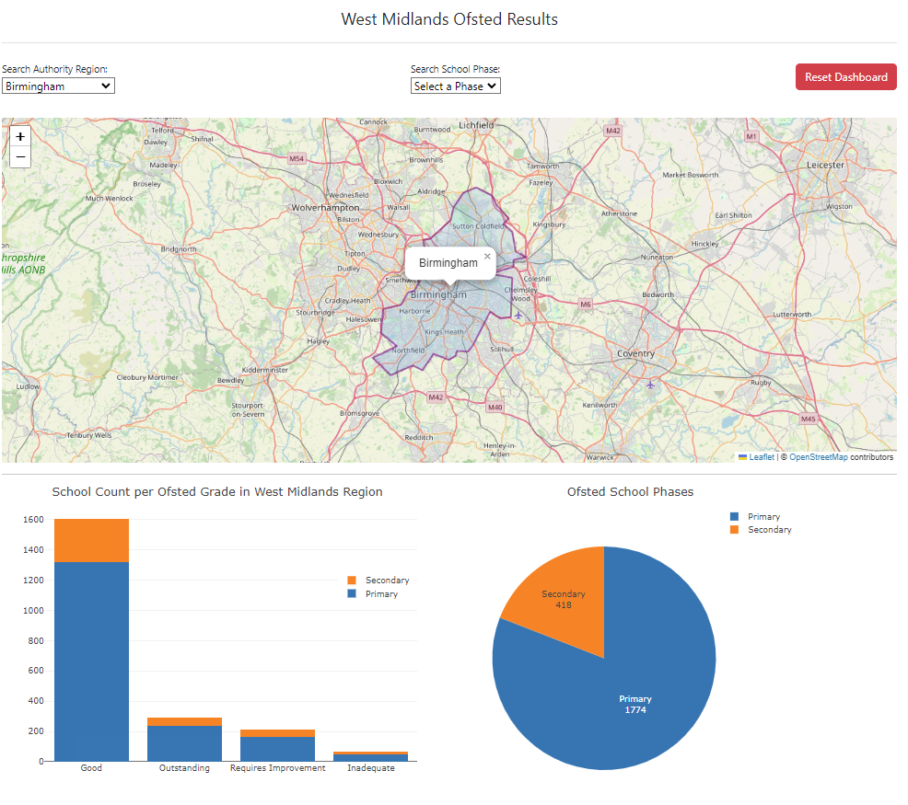
DASHBOARD

Slide 8
RESULTS & CONCLUSION
Our examination revealed that the West Midlands is home to a total of 2,192 primary and secondary schools. Among these, 19.1% (418) are classified as secondary schools, while a substantial 80.9% (1,774) are primary schools. In the secondary education, there are 53 schools with a "Good" rating, 51 schools marked as "Requires Improvement," 23 schools labeled "Inadequate," and an impressive 53 schools achieving an "Outstanding" rating.
In the primary education sector, a significant majority of 1,318 schools have received a "Good" rating from Ofsted. Furthermore, 237 schools have been recognized as "Outstanding," 163 schools are categorized as "Requires Improvement," and 46 schools have been rated as "Inadequate".

